Slide 1
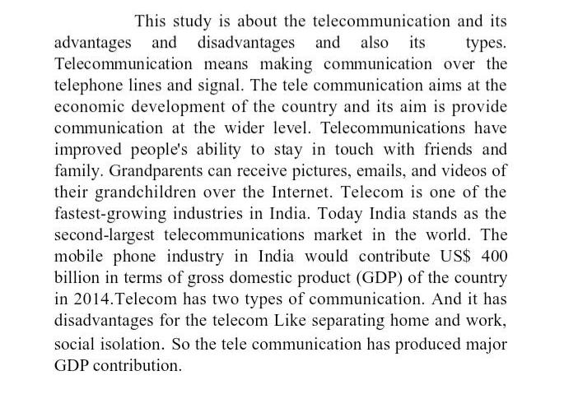
Abstract

Slide 2

Objectives OF Telecommnication

Slide 3
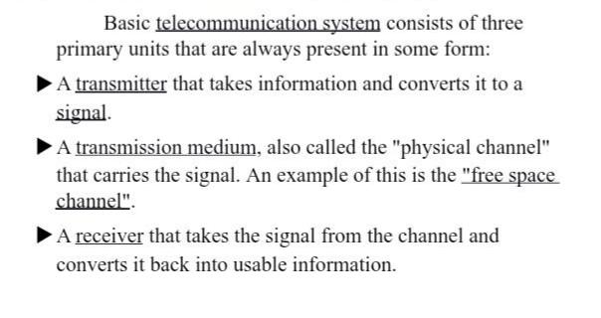
Key Concepts

Slide 4
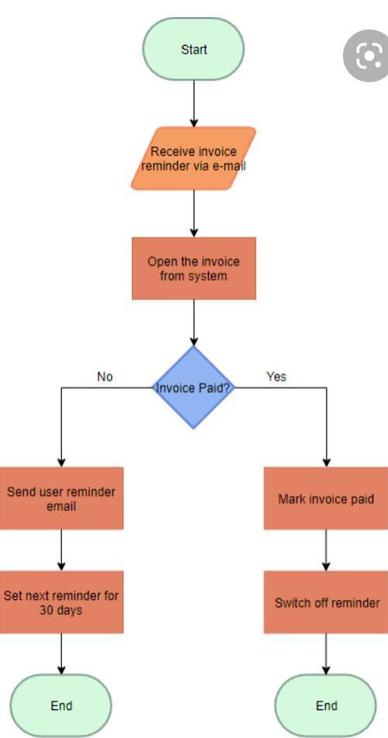
Process Of Teleapp

Slide 5
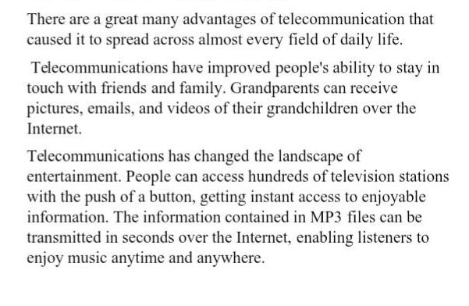
Benefits Of Telecommunication App

Slide 6
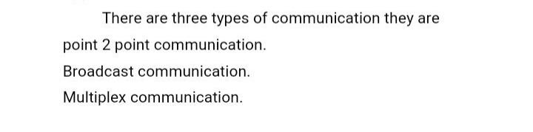
Types of Communication

Slide 7
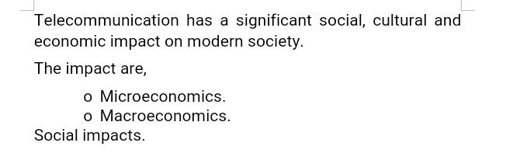
Social Impacts

Slide 8
CODE
package com.abhay
public class main
{public static void main(String[] args) {// DeskPhone myphone=new
Deskphone(my number "123456");// myphone.powerOn();//
myphone.callphone(phoneNumber"123456");//
myphone.answer();mobilephone myphone=new mobilephone(my number"123456");
myphone.poweron();
myphone.answer();package com.abhaypublic class main {public static void main(String[] args) {// DeskPhone myphone=new Deskphone(my number "123456");//
myphone.powerOn();// myphone.callphone(phoneNumber"123456");//
myphone.answer();mobilephone myphone=new mobilephone(my number"123456");myphone.poweron();myphone.callphone(phoneNumber"123456");myphone.answer();

Slide 9
package com.abhaypublic class telephone {void powerOn();
void dial(String phoneNumber);
void answer();
boolean callPhone(String ohoneNumber);
boolean isRinging();}

Slide 10
package com.abhay;
public class deskphone implements telecom {private String myNumber;
private boolean is ringing;
public deskphone(string myNumber){ this.myNumber=mynumber; }
@override public void poweOn() {System.out.println("Desk phone is always powered");
}@overridepublic void dial (string phonenumber) {Sytem.out.println("now ringing"+phoneNumber+"on deskphone"); }
@override public void answer() { is ringing){ System.out.println("Ansering the desk phone"); I
is ringing=false;}
else { System.out.println("Phone is not ringing");
}@overridepublic boolean callPhone(String phoneNumber) { I
If phoneNumber ==myNumber) {
isRinging=true;
System.out.println(“Phone ringing”);}
Else { System.out.println(“”); I
Stringing=false;}
Return isRinging;}
@overridepublic boolean isRinging() { return isRinging;}}

Slide 11
package com.abhay;
public class mobilephone implements telephone{
private boolean isRinging;
private boolean is powerOn;
public Mobilephone(string myNumber){ t
@override public void poweOn() {
ispoweron=true;
System.out.println("phone powered on");;
@override
public void dial (string phonenumber) {
Sytem.out.println("now ringing"+phoneNumber+"on deskphone");
@override
public void answer() {
if (is ringing && ispowerOn){
System.out.println(“Answering the phone”);
is ringing=false;
else {
@override
public boolean callPhone(String phoneNumber) { I
f(phoneNumber ==myNumber && ispowerOn) { I
isrinhing=true; S
ystem.out.println("Phone ringing"); }else {
System.out.println("Either wrong number entered or phone is off");
isRinging=false; }
return isRinging; }
@override
pblic boolean isRinging() {
return isRinging; }

Slide 12
Output:
Phone powered on
Phone ringing
Answering the phone
Process finished with exit code 0

Slide 13
THANK YOU
BY
VAISHNAVI.T

